Slide 1

Statistical Computation Methods for Data Science Unit-V Lecture 3
By
S.U.RAVI KUMAR CHAVALI
Assistant professor of Mathematics
Department of Science and Humanities
Sreenidhi Institute of Science and Technology
Yamnampet, Ghatkesar.
1
Notes:
1

Slide 2
We discuss the following in today’s Lecture
Measurement of Secular trend

Slide 3
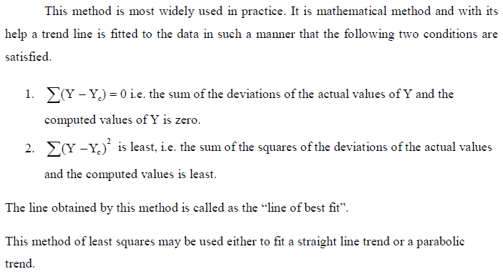
Method of Least Squares

Slide 4
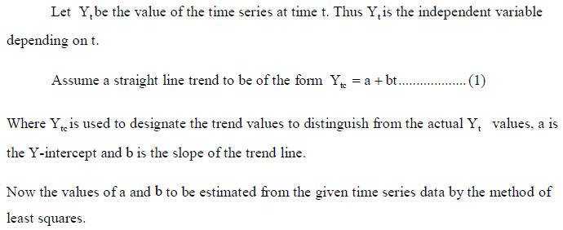
Fitting of a straight line trend by the method of least squares:

Slide 5


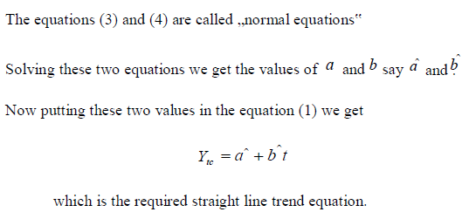

Slide 6
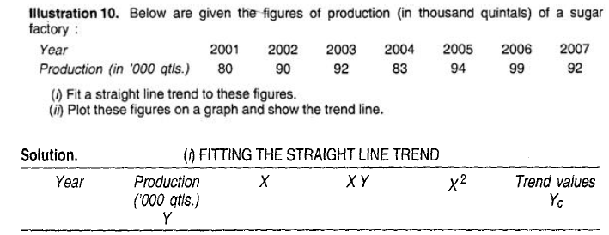

Slide 7
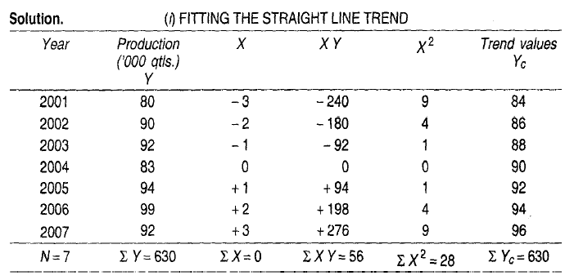

Slide 8
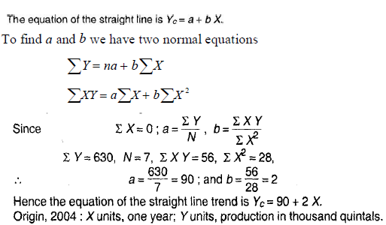

Slide 9
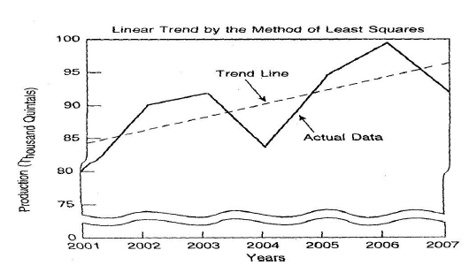

Slide 10
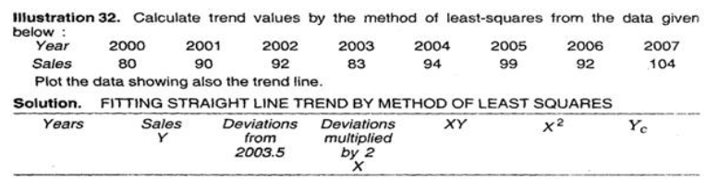

Slide 11
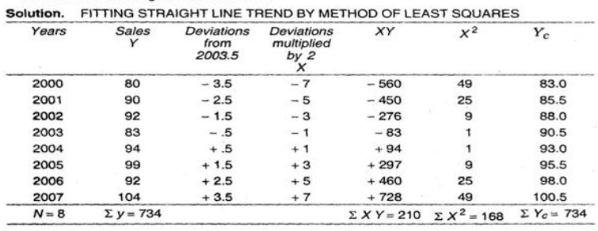

Slide 12
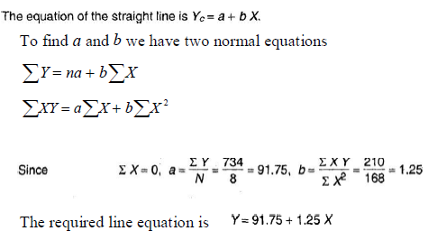

Slide 13
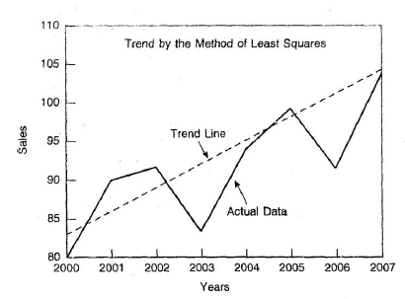

Slide 14



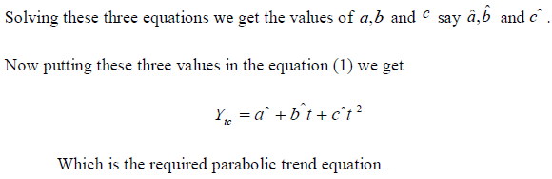

Slide 15
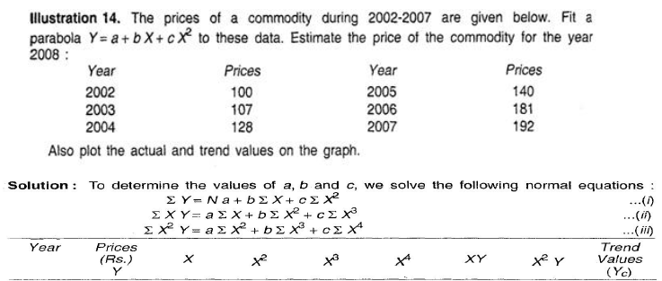

Slide 16
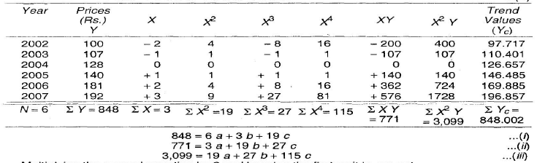

Slide 17
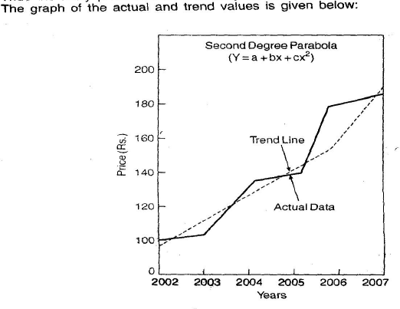

Slide 18
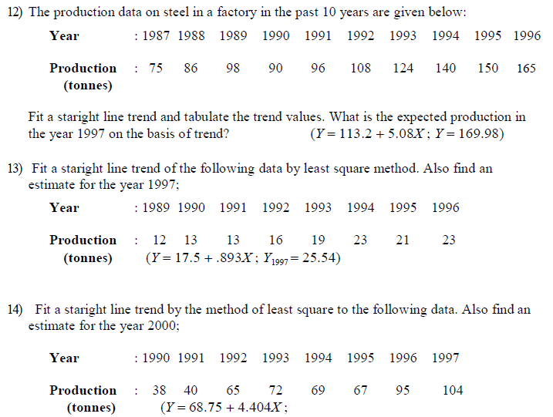


Slide 19
THANK YOU
Notes:
19

